Slide 1
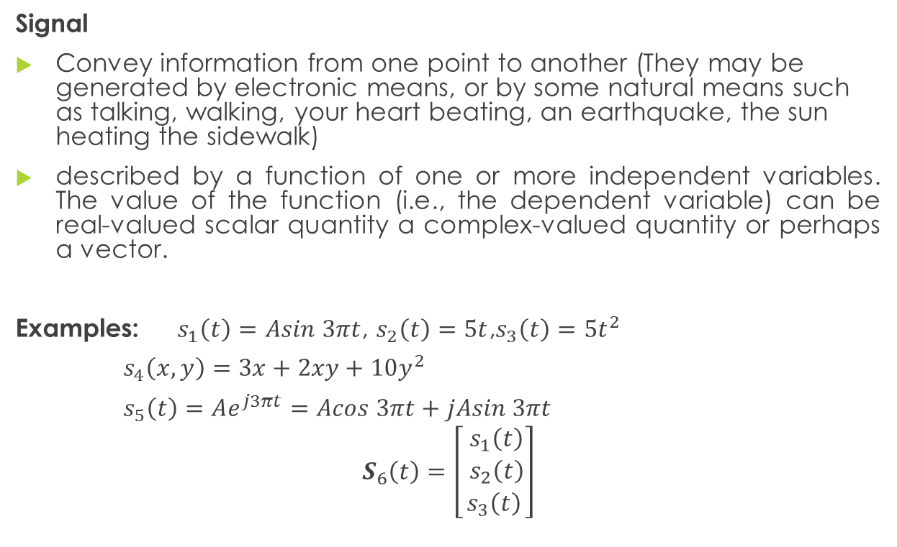
SIGNALS, SYSTEMS, AND SIGNAL PROCESSING
Signal
Convey information from one point to another (They may be generated by electronic means, or by some natural means such as talking, walking, your heart beating, an earthquake, the sun heating the sidewalk)
described by a function of one or more independent variables. The value of the function (i.e., the dependent variable) can be real-valued scalar quantity a complex-valued quantity or perhaps a vector.
Examples: $s_{1}\left(t\right)=Asin 3πt$, $s_{2}\left(t\right)=5t$,$s_{3}\left(t\right)=5t^{2}$
$s_{4}\left(x, y\right)=3x+2xy+10y^{2}$
$s_{5}\left(t\right)=Ae^{j3πt}=Acos 3πt+jAsin 3πt$
$$S_{6}\left(t\right)=\left[\begin{matrix} s_{1}\left(t\right) \\ s_{2}\left(t\right) \\ s_{3}\left(t\right)\end{matrix}\right]$$

Slide 2

SIGNALS, SYSTEMS, AND SIGNAL PROCESSING
System
process signals to produce a modified or transformed version of the original signal
defined as a physical device that performs an operation on a signal.
Example. A filter used to reduce the noise and interference corrupting a desired information-bearing signal is called a system.
Signal Processing –the operation on or analysis of signals, or measurements of time-varying or spatially varying physical quantities.

Slide 3
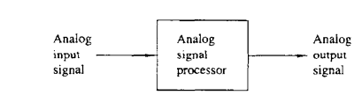

Basic Elements of a Digital Signal Processing System

Slide 4
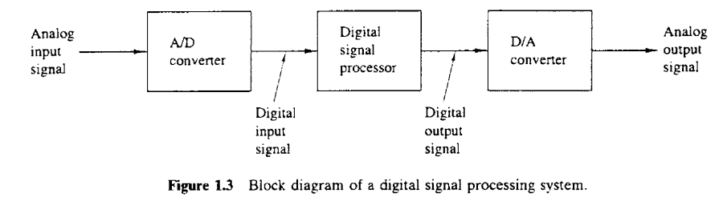

Slide 5


Multichannel and Multidimensional Signals

Slide 6
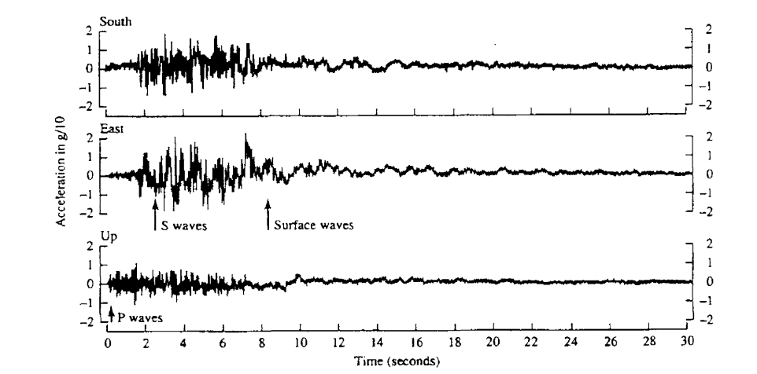

Slide 7
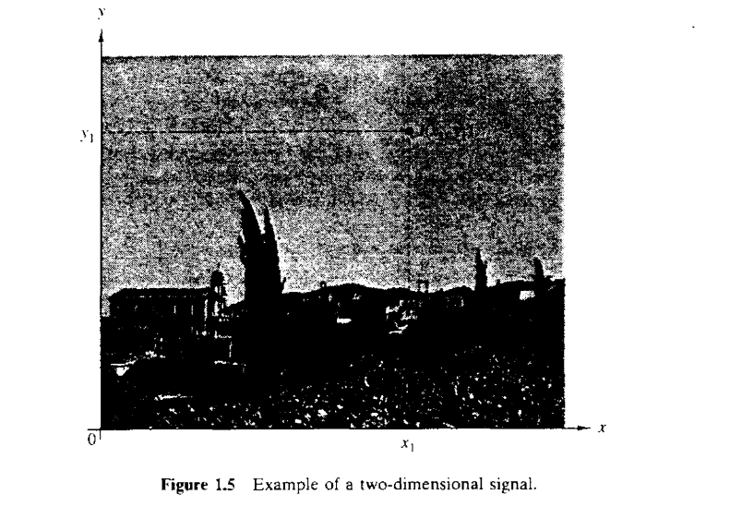

Slide 8
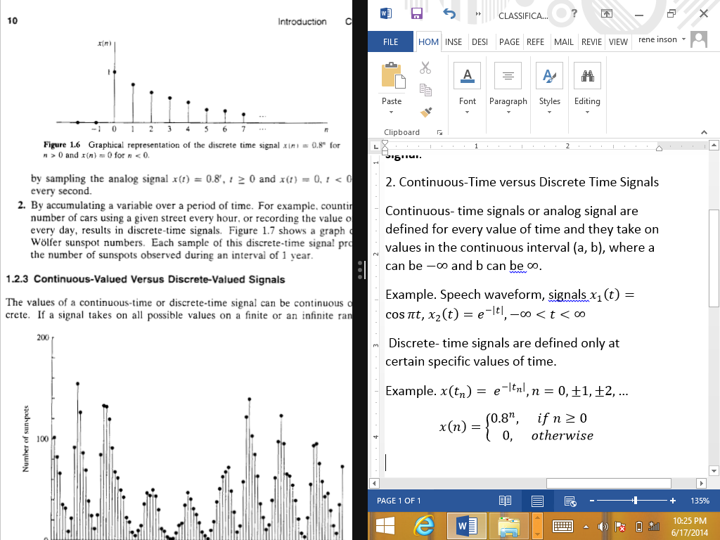

Continuous-Time versus Discrete Time Signals
Discrete- time signals are defined only at certain specific values of time. To emphasize the discrete- time nature of a signal, we shall denote such a signal as $x\left(n\right)$or x[n] instead of $x\left(t\right).$ If the time instants $t_{n}$are equally spaced (i.e., $t_{n}=nT$), the notation $x(nT)$ is also used.
Graphical representation of the discrete time signal $x\left[n\right]={0.8}^{n}$ for $n>0$ and $x\left[n\right]=0$ for $n<0$

Slide 9
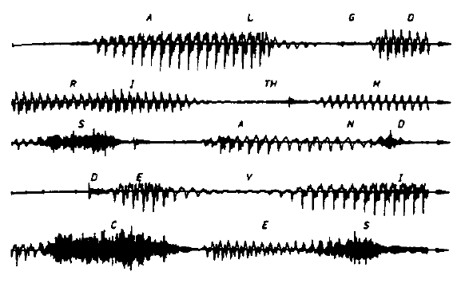

Continuous-Time versus Discrete Time Signals
Continuous- time signals or analog signals are defined for every value of time and they take on values in the continuous interval (a, b), where a can be $−∞$ and b can be $∞$.
Example. Speech waveform, signals $x_{1}\left(t\right)=\cos{πt}$, $x_{2}\left(t\right)=e^{−\left|t\right|}, −∞<t<∞$
Example of a speech signal

Slide 10
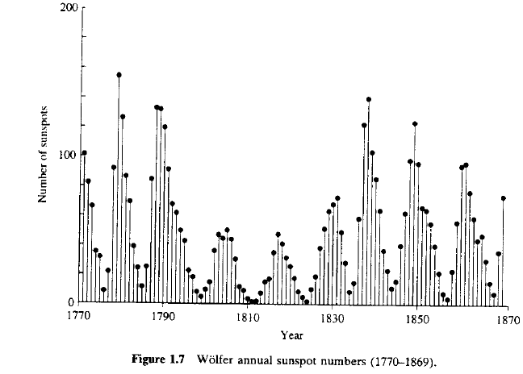
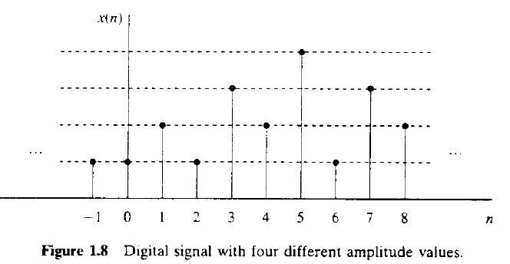
Continuous-Valued versus Discrete-Valued Signals
Continuous- Valued Signals- if a signal takes on all possible values on a finite or an infinite range.
Discrete –Valued Signal – if the signal takes on values from a finite set of possible values.

Slide 11
Deterministic vs Random Signals
Deterministic - Any signal that can be uniquely described by an explicit mathematical expression, a table of data, or a well-defined rule.
Random - are signals that either cannot be described to any reasonable degree of accuracy by explicit mathematical formulas, or such a description is too com plicated to be of any practical use

Slide 12
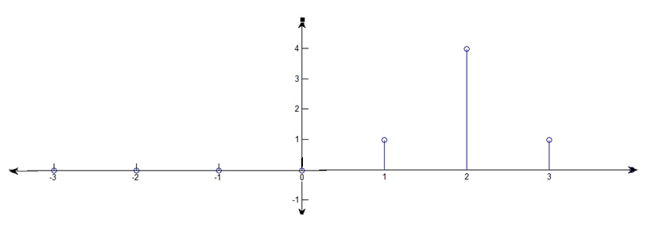
Discrete-Time Signal or Sequence
Graphically, it can be represented as

Slide 13
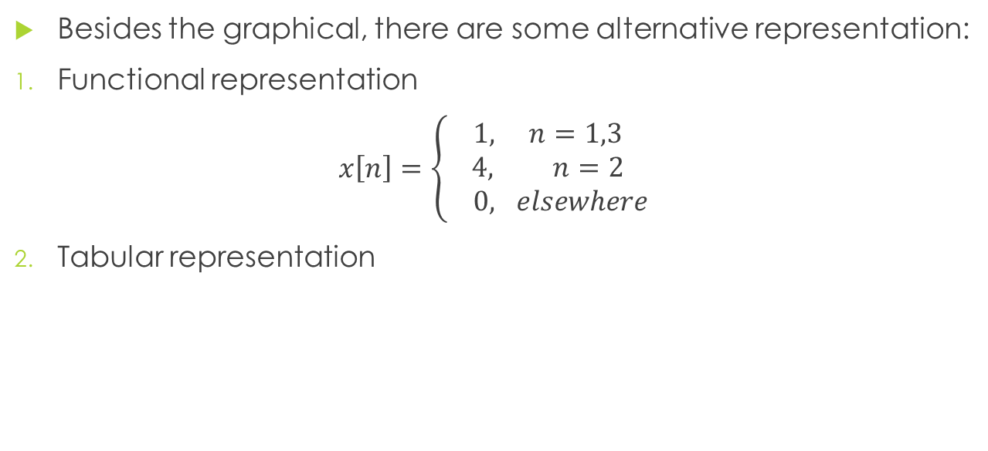
Discrete Time Signals or Sequence
Besides the graphical, there are some alternative representation:
Functional representation
$x\left[n\right]=\left\{\begin{aligned}1, n=1,3 \\ 4, n=2 \\ 0, elsewhere\end{aligned}\right.$
Tabular representation
n | … | -2 | -1 | 0 | 1 | 2 | 3 | 4 | …
x[n] | … | 0 | 0 | 0 | 1 | 4 | 1 | 0 | …

Slide 14
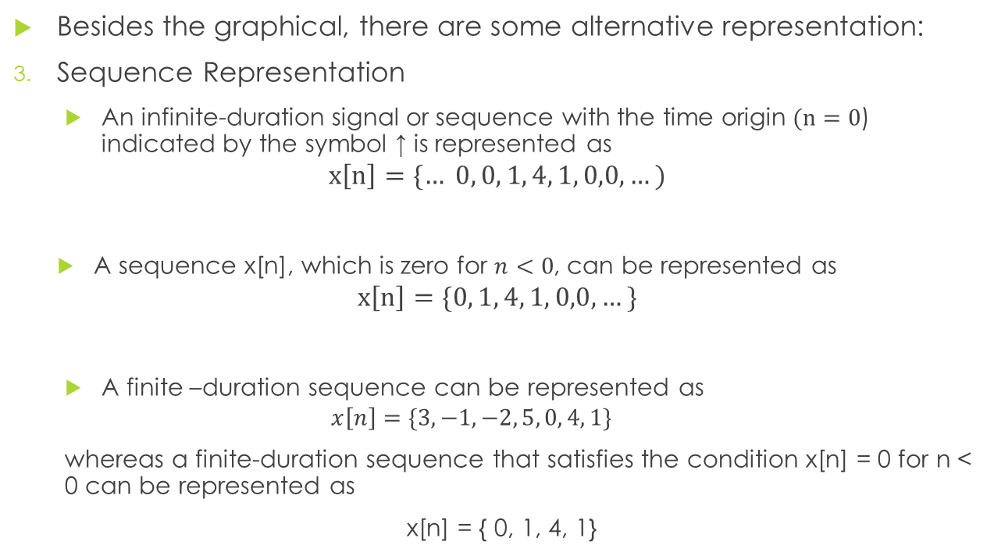
Discrete Time Signals or Sequence
Besides the graphical, there are some alternative representation:
Sequence Representation
An infinite-duration signal or sequence with the time origin $(n=0$) indicated by the symbol ↑ is represented as
$$x\left[n\right]=\{… 0, 0, 1, 4, 1, 0,0,…)$$
A sequence x[n], which is zero for $n<0$, can be represented as
$$x\left[n\right]=\{0, 1, 4, 1, 0,0,…\}$$
A finite –duration sequence can be represented as
$$x\left[n\right]=\{3,−1,−2, 5, 0, 4, 1\}$$
whereas a finite-duration sequence that satisfies the condition x[n] = 0 for n < 0 can be represented as
x[n] = { 0, 1, 4, 1}

Slide 15
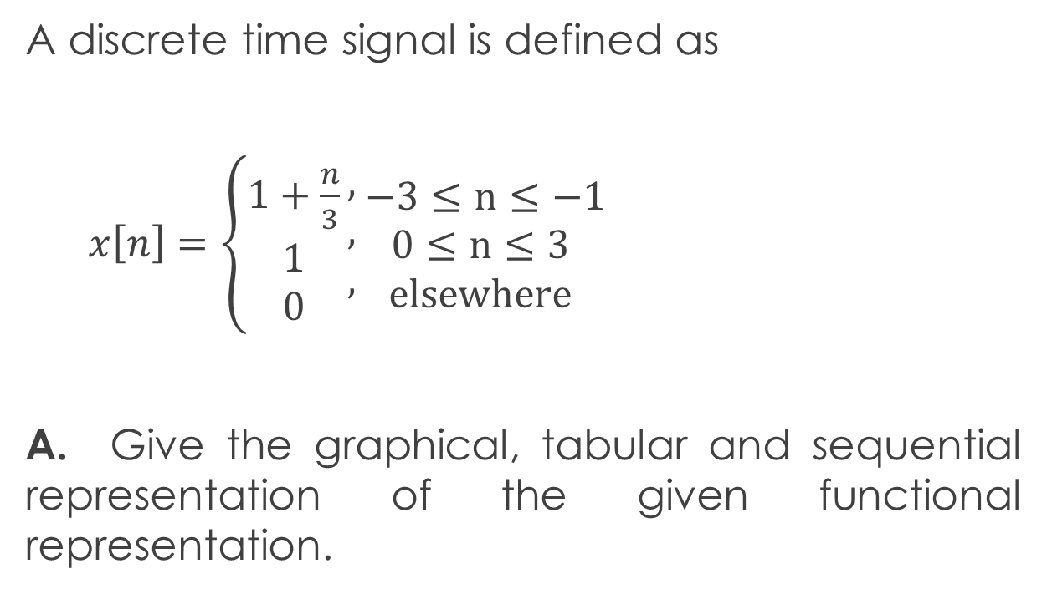
SEATWORK
A discrete time signal is defined as
$x\left[n\right]=\left\{\begin{aligned}1+\frac{n}{3} \\ 1 \\ 0\end{aligned}\right.\begin{matrix}, \\ , \\ ,\end{matrix}\begin{matrix} −3≤n≤−1 \\ 0≤n≤3 \\ elsewhere\end{matrix}$
A. Give the graphical, tabular and sequential representation of the given functional representation.

Slide 16
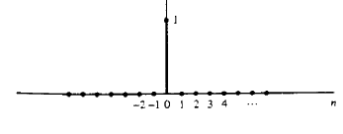
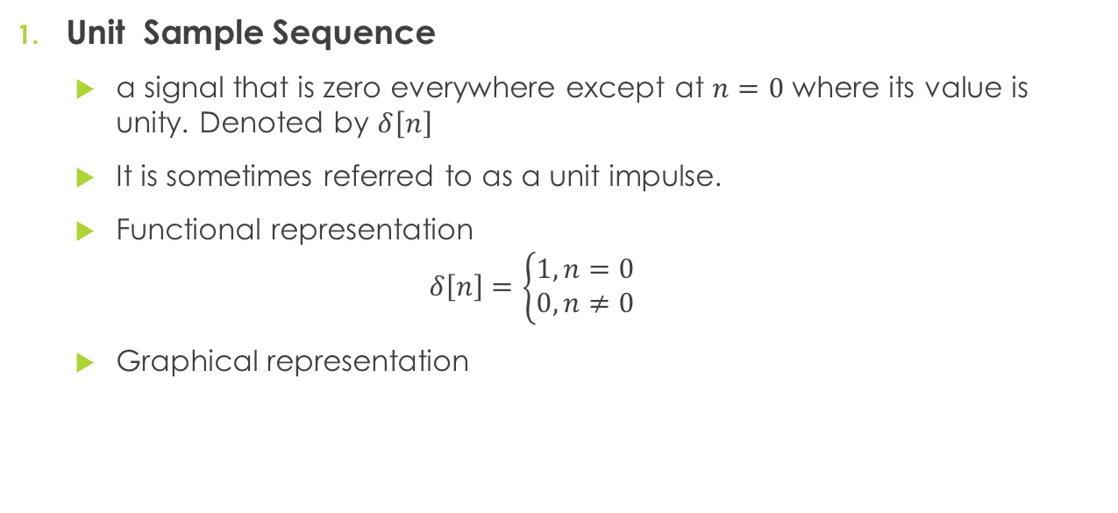

Some Elementary Discrete Time Signal
Unit Sample Sequence
a signal that is zero everywhere except at $n=0$ where its value is unity. Denoted by $δ\left[n\right]$
It is sometimes referred to as a unit impulse.
Functional representation
$$δ\left[n\right]=\left\{\begin{aligned}1, n=0 \\ 0, n≠0\end{aligned}\right.$$
Graphical representation
$$δ\left[n\right]$$

Slide 17
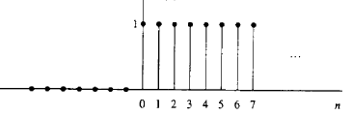


Some Elementary Discrete Time Signal
Unit Step Signal
Denoted by u[n]
Functional representation
$$u\left[n\right]=\left\{\begin{aligned}1, n≥0 \\ 0, n<0\end{aligned}\right.$$
Graphical representation
u$\left[n\right]$

Slide 18
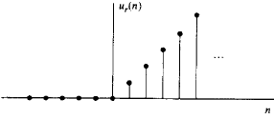


Some Elementary Discrete Time Signal
Unit Ramp Signal
denoted by
$$u_{r}[n]=\left\{\begin{aligned}n, n≥0 \\ 0, n<0\end{aligned}\right.$$
$\text{Graphical} \text{representation}$
$$u_{r}[n]$$

Slide 19
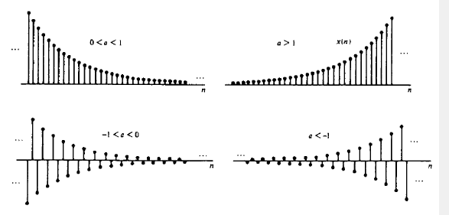

Some Elementary Discrete Time Signal
Exponential signal
A sequence of the form $x\left[n\right]=a^{n} for all n$
Graphical representation (Parameter a is real)

Slide 20
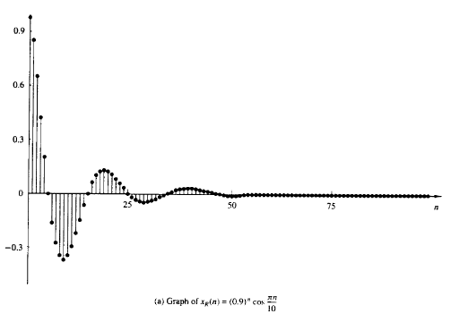
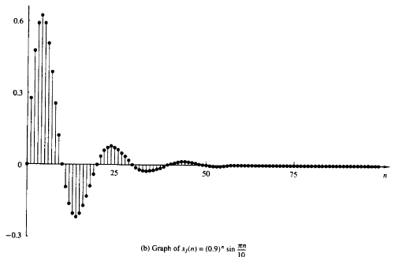
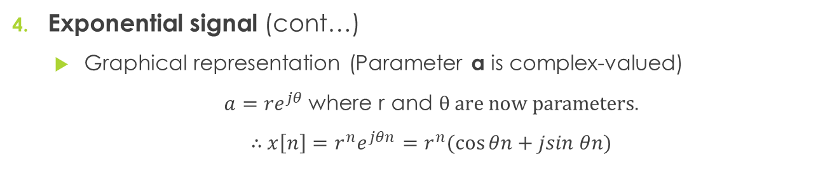
Some Elementary Discrete Time Signal
Exponential signal (cont…)
Graphical representation (Parameter a is complex-valued)
$a={re}^{jθ}$where r and θ are now parameters.
∴ $x\left[n\right]={r^{n}e}^{jθn}=r^{n}(\cos{θn}+jsin θn)$

Slide 21
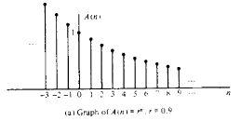
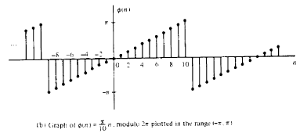
Some Elementary Discrete Time Signal
Graph of amplitude and phase function of a complex-valued exponential signal

Slide 22
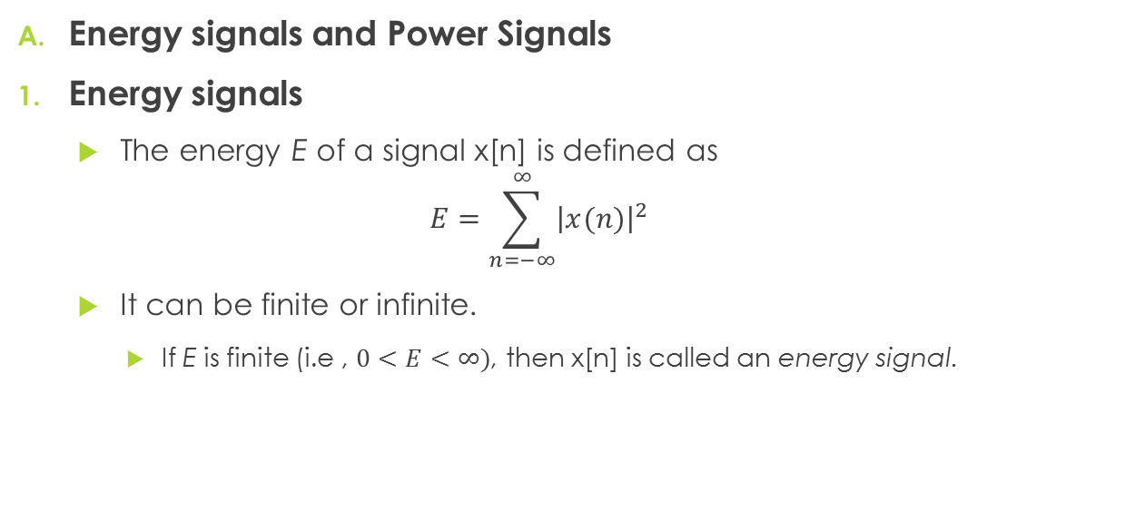
Classification of Discrete-Time Signals
Energy signals and Power Signals
Energy signals
The energy E of a signal x[n] is defined as
$$E=\sum_{n=−∞}^{∞}{{\left|x(n)\right|}^{2}}$$
It can be finite or infinite.
If E is finite (i.e , $0<E<∞)$, then x[n] is called an energy signal.

Slide 23
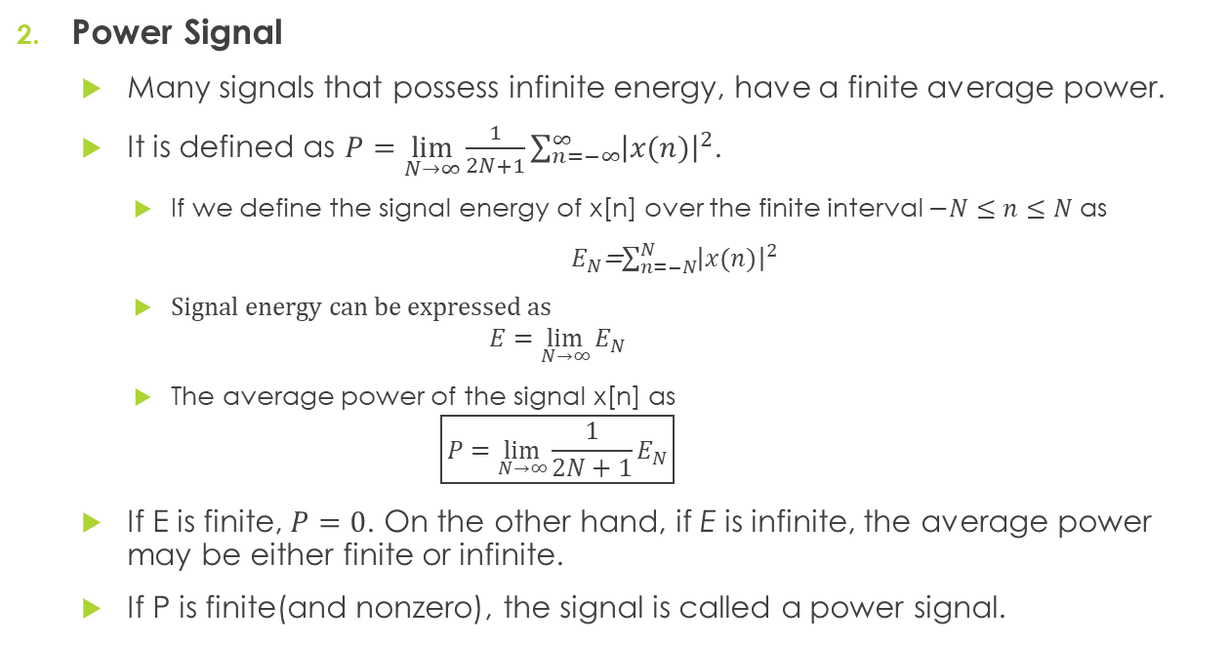
Classification of Discrete-Time Signals
Power Signal
Many signals that possess infinite energy, have a finite average power.
It is defined as $P=\lim_{N→∞}{\frac{1}{2N+1}}\sum_{n=−∞}^{∞}{{\left|x(n)\right|}^{2}}$.
If we define the signal energy of x[n] over the finite interval $−N≤n≤N$ as
$E_{N}$=$\sum_{n=−N}^{N}{{\left|x(n)\right|}^{2}}$
Signal energy can be expressed as
$$E=\lim_{N→∞}{E_{N}}$$
The average power of the signal x[n] as
$$\boxed{P=\lim_{N→∞}{\frac{1}{2N+1}}E_{N}}$$
If E is finite, $P=0$. On the other hand, if E is infinite, the average power may be either finite or infinite.
If P is finite(and nonzero), the signal is called a power signal.

Slide 24
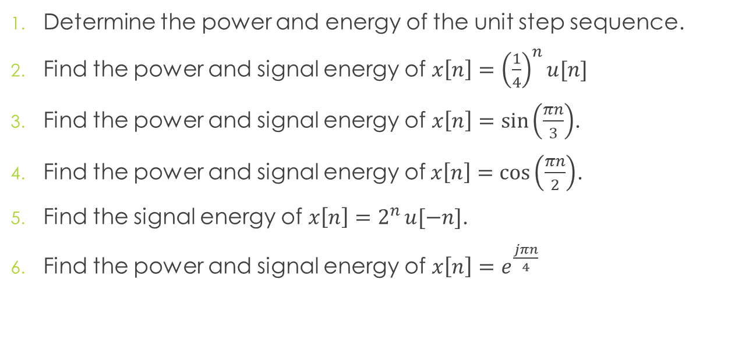
Sample Problems:
Determine the power and energy of the unit step sequence.
Find the power and signal energy of $x\left[n\right]={\left(\frac{1}{4}\right)}^{n}u[n]$
Find the power and signal energy of $x\left[n\right]=\sin\left(\frac{πn}{3}\right)$.
Find the power and signal energy of$x\left[n\right]=\cos\left(\frac{πn}{2}\right)$.
Find the signal energy of $x\left[n\right]=2^{n}{u[−n]}$.
Find the power and signal energy of $x\left[n\right]=e^{\frac{jπn}{4}}$

Slide 25
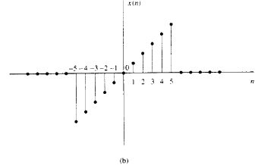
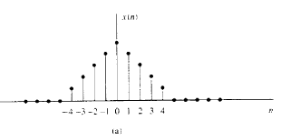

Classification of Discrete-Time Signals
Symmetric(Even) and Antisymmetric (Odd)
A real-valued signal x[n] is called symmetric(even) if $x\left[−n\right]=x\left[n\right].$
A real-valued signal x[n] is called antisymmetric(odd) if $x\left[−n\right]=−x\left[n\right].$
Examples of signals with even and odd symmetry.

Slide 26
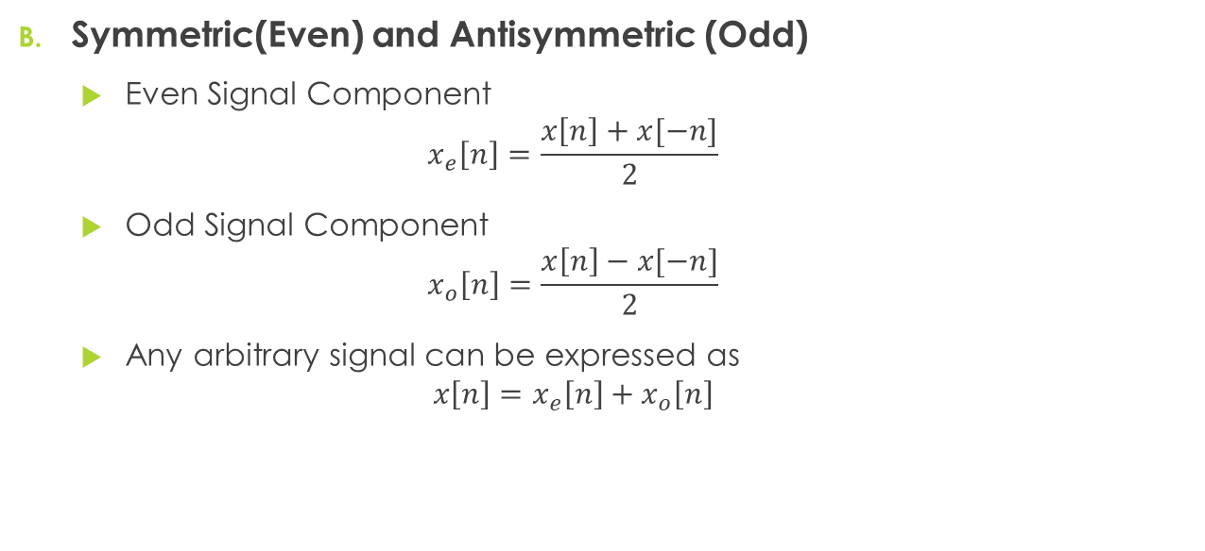
Classification of Discrete-Time Signals
Symmetric(Even) and Antisymmetric (Odd)
Even Signal Component
$$x_{e}\left[n\right]=\frac{x\left[n\right]+x[−n]}{2}$$
Odd Signal Component
$$x_{o}\left[n\right]=\frac{x\left[n\right]−x[−n]}{2}$$
Any arbitrary signal can be expressed as
$${x\left[n\right]=x}_{e}\left[n\right]+x_{o}\left[n\right]$$

Slide 27

Sample Problem:
Find the even and odd part of the function $x[n]=3^{n}$
What are the even and odd parts of the function $x\left[n\right]=3e^{\frac{jπn}{5}}$
What are the even and odd parts of the function $x\left[n\right]=\{2,−2,6,−2\}$

Slide 28
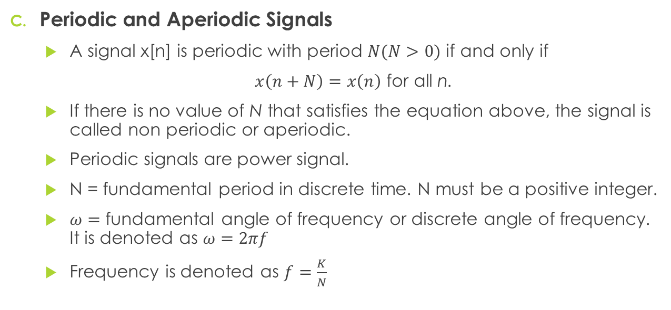
Classification of Discrete-Time Signals
Periodic and Aperiodic Signals
A signal x[n] is periodic with period $N(N>0)$ if and only if
$x\left(n+N\right)=x\left(n\right)$ for all n.
If there is no value of N that satisfies the equation above, the signal is called non periodic or aperiodic.
Periodic signals are power signal.
N = fundamental period in discrete time. N must be a positive integer.
$ω=$ fundamental angle of frequency or discrete angle of frequency. It is denoted as $ω=2πf$
Frequency is denoted as $f=\frac{K}{N}$

Slide 29
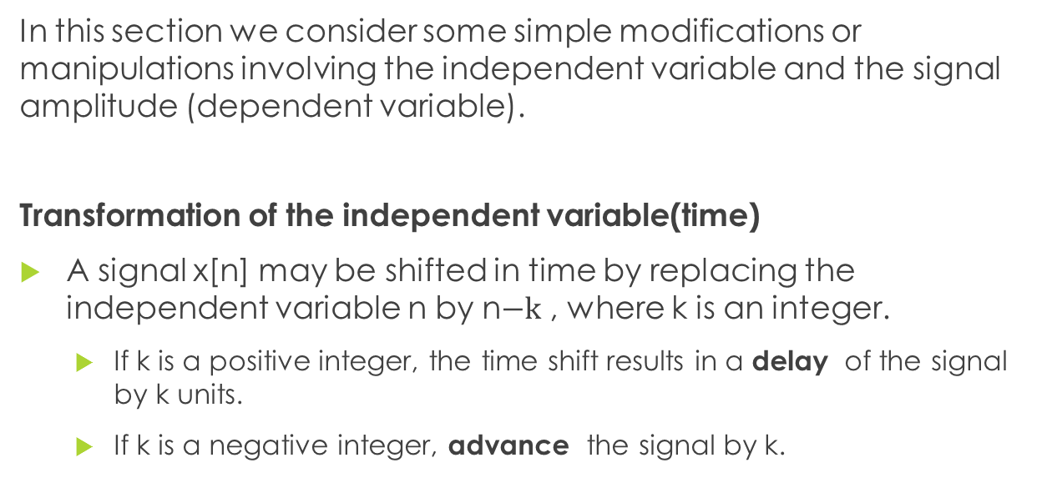
Simple Manipulation of Discrete-Time Signals
In this section we consider some simple modifications or manipulations involving the independent variable and the signal amplitude (dependent variable).
Transformation of the independent variable(time)
A signal x[n] may be shifted in time by replacing the independent variable n by n$−k$ , where k is an integer.
If k is a positive integer, the time shift results in a delay of the signal by k units.
If k is a negative integer, advance the signal by k.

Slide 30



Simple Manipulation of Discrete-Time Signals
Transformation of the independent variable(time) (cont…)
Example:
The signal is graphically illustrated below:
Show the graphical representation of (a) $x\left[n−3\right]$ and (b) $x\left[n+2\right]$
$$x[n]$$

Slide 31
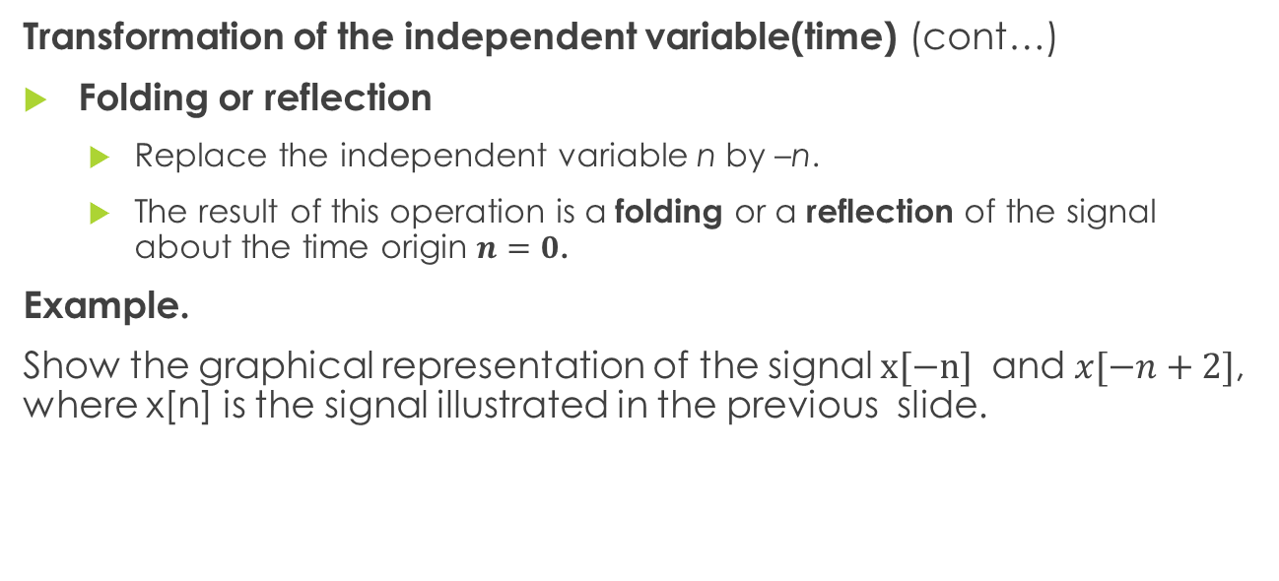
Simple Manipulation of Discrete-Time Signals
Transformation of the independent variable(time) (cont…)
Folding or reflection
Replace the independent variable n by –n.
The result of this operation is a folding or a reflection of the signal about the time origin $n=0$.
Example.
Show the graphical representation of the signal $x[−n]$ and $x[−n+2]$, where x[n] is the signal illustrated in the previous slide.

Slide 32
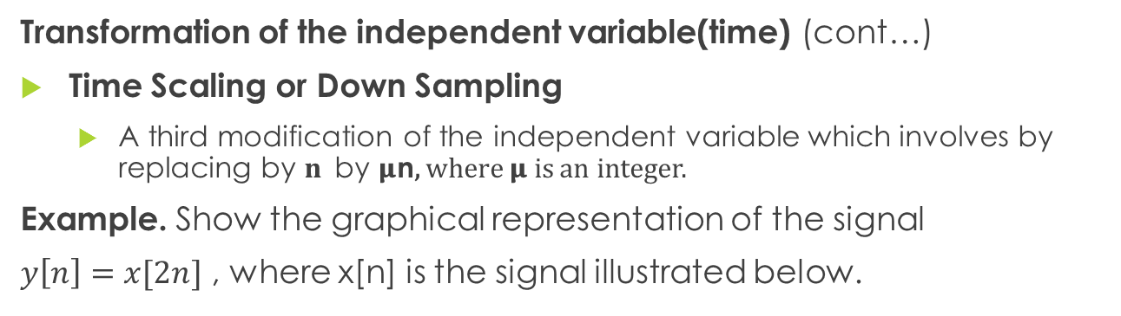
Simple Manipulation of Discrete-Time Signals
Transformation of the independent variable(time) (cont…)
Time Scaling or Down Sampling
A third modification of the independent variable which involves by replacing by $n$by 𝛍n, where 𝛍 is an integer.
Example. Show the graphical representation of the signal
$y\left[n\right]=x[2n]$ , where x[n] is the signal illustrated below.

Slide 33
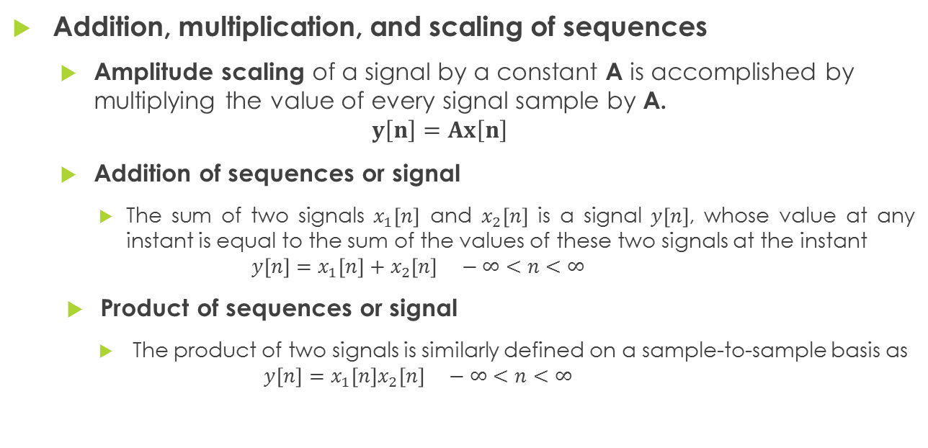
Simple Manipulation of Discrete-Time Signals
Addition, multiplication, and scaling of sequences
Amplitude scaling of a signal by a constant A is accomplished by multiplying the value of every signal sample by A.
$$y\left[n\right]=Ax\left[n\right]$$
Addition of sequences or signal
The sum of two signals $x_{1}\left[n\right]$ and $x_{2}\left[n\right]$ is a signal $y\left[n\right]$, whose value at any instant is equal to the sum of the values of these two signals at the instant
$$y\left[n\right]=x_{1}\left[n\right]+x_{2}\left[n\right] −∞<n<∞$$
Product of sequences or signal
The product of two signals is similarly defined on a sample-to-sample basis as
$$y\left[n\right]=x_{1}\left[n\right]x_{2}\left[n\right] −∞<n<∞$$
Notes:
Example:

Slide 34
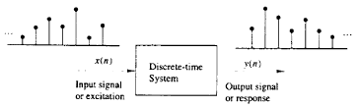
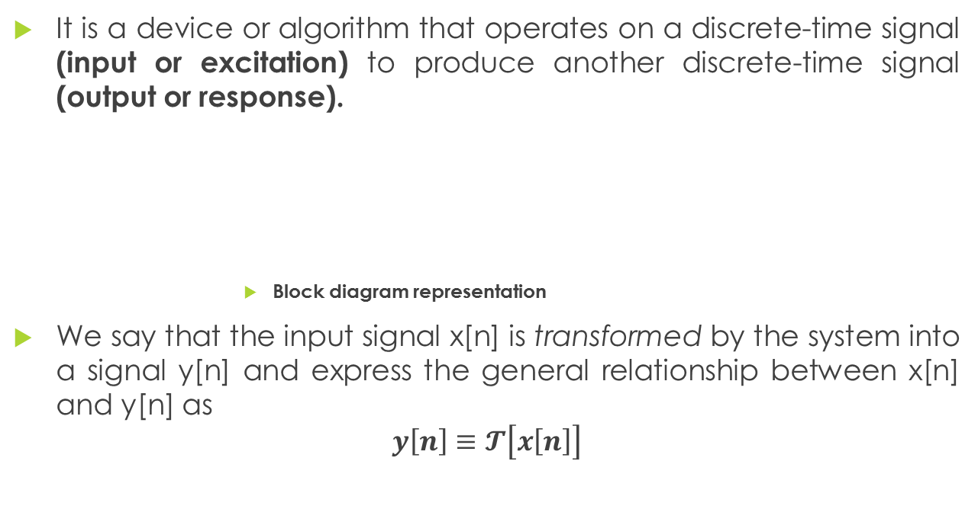
DISCRETE TIME SYSTEMS
It is a device or algorithm that operates on a discrete-time signal (input or excitation) to produce another discrete-time signal (output or response).
Block diagram representation
We say that the input signal x[n] is transformed by the system into a signal y[n] and express the general relationship between x[n] and y[n] as
$$y\left[n\right]≡𝓣\left[x\left[n\right]\right]$$

Slide 35
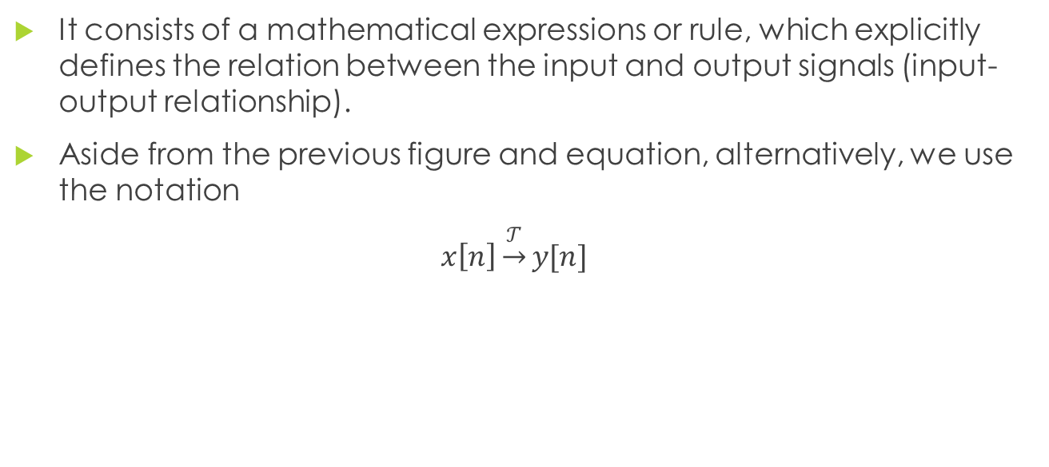
Input-Output Description of the System
It consists of a mathematical expressions or rule, which explicitly defines the relation between the input and output signals (input-output relationship).
Aside from the previous figure and equation, alternatively, we use the notation
$x\left[n\right]\underset{→}{𝒯}y[n]$

Slide 36

Input-Output Description of the System
Example:
Determine the response of the following the systems to the input signal
$$x\left[n\right]=\left\{\begin{aligned}\left|n\right| \\ 0 \end{aligned}\right.\begin{matrix} , −3≤n≤3 \\ , otherwise \end{matrix}$$
$y\left[n\right]=x\left[n\right]$
$y\left[n\right]=x\left[n−1\right]$
$y\left[n\right]=x\left[n+1\right]$
$y\left[n\right]=\frac{1}{3}\left[x\left[n+1\right]+x\left[n\right\}+x\left[n−1\right]\right]$

Slide 37
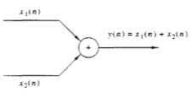
Block Diagram Representation of Discrete-Time Systems
Adder

Slide 38

Block Diagram Representation of Discrete-Time Systems
Constant Multiplier

Slide 39

Block Diagram Representation of Discrete-Time Systems
Signal Multiplier

Slide 40
Block Diagram Representation of Discrete-Time Systems
Unit delay element

Slide 41
Block Diagram Representation of Discrete-Time Systems
A unit advance element

Slide 42


EXAMPLE NO. 1
1
+
x[n]
y[n]
5/6
+
$$z^{−1}$$
-1/6
$$z^{−2}$$
Give the input-output relation of the given system above

Slide 43
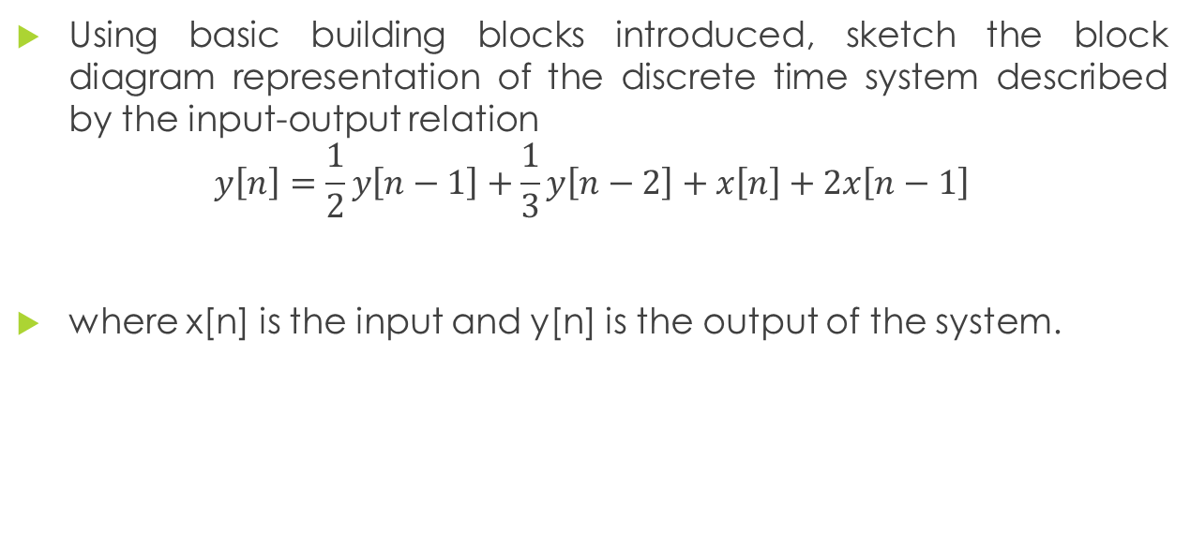
EXAMPLE NO. 2
Using basic building blocks introduced, sketch the block diagram representation of the discrete time system described by the input-output relation
$$y\left[n\right]=\frac{1}{2}y\left[n−1\right]+\frac{1}{3}y\left[n−2\right]+x\left[n\right]+2x\left[n−1\right]$$
where x[n] is the input and y[n] is the output of the system.

Slide 44
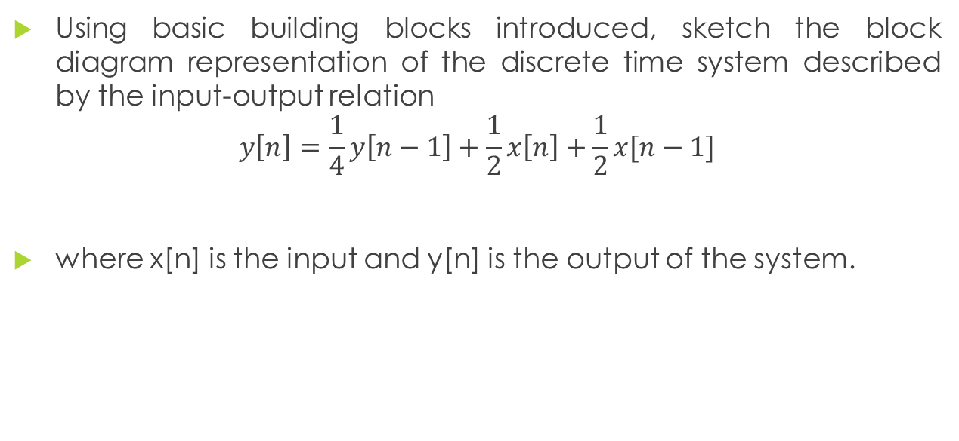
EXAMPLE NO. 3
Using basic building blocks introduced, sketch the block diagram representation of the discrete time system described by the input-output relation
$$y\left[n\right]=\frac{1}{4}y\left[n−1\right]+\frac{1}{2}x\left[n\right]+\frac{1}{2}x[n−1]$$
where x[n] is the input and y[n] is the output of the system.

